Slide 1


Humana-Mays Healthcare Analytics
Case Competition
Social Determinants of Health Transportation Challenges
HYGIEIA
Team: Plaksha Kapoor, Tushar Agrawal, Archit Matta
Columbia Business School, Columbia School of Engineering & Applied Sciences

Slide 2



Our Team
Plaksha Kapoor
MS in Business Analytics, Columbia University
Tushar Agrawal
MS in Data Science, Columbia University
Archit Matta
MS in Data Science, Columbia University

Slide 3
Transportation - A Key Social Determinant of Health
Social and Economic Factors - such as access to healthy food, housing instability, limited access to transportation - account for 40 percent of an individual’s overall health
Social and Economic Factors
Physical Environment
Overall Health
Health Behaviour
Clinical Care
Transportation is the third most commonly cited barrier to accessing health services
Each year, 3.6 Million People in the US do not obtain medical care due to Transportation Barriers

Slide 4



Transportation Issues and their Impact
Common Types of Transportation Issues
Policy and Awareness Issues
Transportation Infrastructure
Health and Disability Accommodations
Average No-Show Rate for Medical Appointments is 30% in the US
The total cost of such missed healthcare appointments is $150 Billion

Slide 5

Data Discovery
Members having No Transportation Issues : 85.3%
Members having Transportation Issues : 14.7%
Random Forest
XGBoost
Dealing with Unbalanced Classes
Undersampling
Oversampling
LightGBM

Slide 6
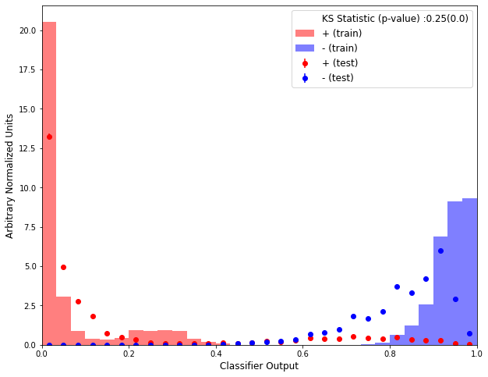
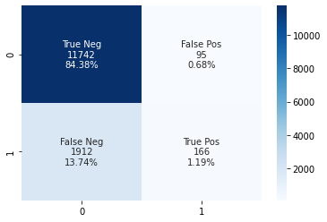
Model Selection and Evaluation Metrics
 | Random Forest | XGBoost | LightGBM | LightGBM (SMOTE)
Accuracy | 0.853 | 0.855 | 0.856 | 0.915
ROC-AUC Score | 0.728 | 0.738 | 0.740 | 0.956
False Positive Rate | 0.0023 | 0.0091 | 0.0080 | 0.0082
KS Statistic Graph confirming overfitting in SMOTE
Confusion Matrix for LightGBM Model

Slide 7
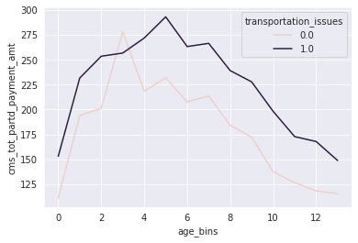
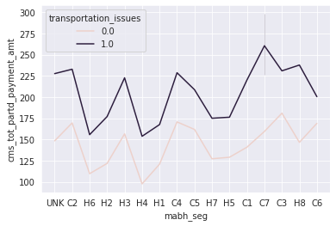
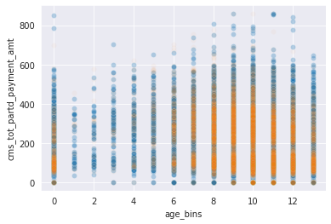
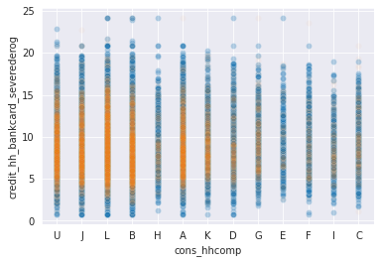
Key Insights
Average CMS Total part-d payment amount VS. age_bins
Average CMS Total part-d payment amount VS. mabh_seg
CMS Total part-d payment amount VS. age_bins
Credit_hh_bankcard_severederog VS. cons_hhcomp

Slide 8
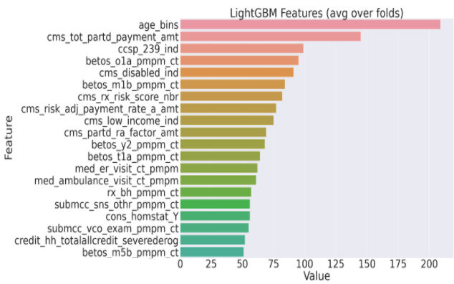
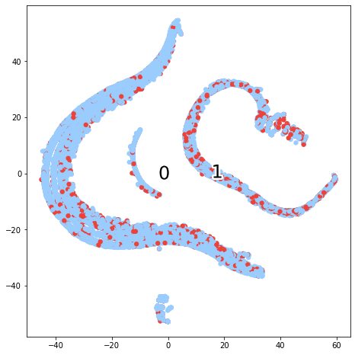
Model Validation
The Top contributing Features based on the model included -
Age, Disability Indicator, Prescription Drug Spend, Member Risk Score, Ambulance Spend and Claims
A t-SNE Plot of the Top 5 Variables based on Model Feature Importance showed a clear distinction between the centroids of the positive and negative classes, thus validating the claim that these features can be used to accurately predict Transportation Issues
Top 20 Features by Feature Importance in Model
t-SNE Plot for Top 5 Variables

Slide 9

Our
Solution

Slide 10


Hygieia for Humana
Empowering Each Member to take their Health in their own hands through a Digital Identity for all their Health Needs (And Beyond!)

Slide 11


Hygieia for Humana
Hygieia, along with Humana understands the importance of Social Determinants of Health in shaping an individual’s health and aims to overcome these barriers
To help members in accessing care and achieving their best health, Hygieia recommends Humana to take a Two-Pronged Approach -
One Immediate Impact Solution and One Long-Term Impact Solution
Tele-Health
Address the Transportation Issues faced by Members on an Immediate Basis
Beyond-Health
Work towards achieving Health Equity for Members in the Long-Run

Slide 12


Hygieia for Humana
Digital Identity as a Health Services Platform - Hygieia’s Key Enabler
Data Collection for Research
Improved Insurance Management
AI Applications can create $150 Billion in annual savings by 2026
Automatic Claims Processing can create $11.1 Billion in annual savings
Managing Patient Treatments
Protecting Patient Records
7.7 Times more Administrative Workers in Healthcare
41.2 Million Records were exposed in 2019 through Data Breaches

Slide 13





Current State of Telehealth
Virtual Healthcare is instrumental in alleviating the distance and transportation barriers involved in healthcare. Telehealth services are the best solution to minimize healthcare risks, reduce transport issues & keep expenses low
50% increase in the Q1 telehealth visits, 2020 as compared with 2019
76% Customers and 64% Providers comfortable in using Telehealth
$250 Billion (20% of all Healthcare) can be virtually enabled
Limited measures for safeguarding information shared on telehealth channels
Challenges
Extra time spent on learning patient medical history in sessions
Difficulty in matching individual identities to digital identifiers in the framework

Slide 14
TeleHealth Solutions
1
Blockchain based EHR for Telehealth
Accountable Care Organizations and Telehealth
2

Slide 15







Blockchain based EHR for Telehealth
Health Insurance Provider
Maintains patient record
Access Patient History
Doctor
Patient
Basic Medical Information of the Patient
Updates patient records
Records consist of
Uses Telehealth Platform
IPFS Hash which is containing the lab reports of the other medical data of the patient
Record
Stored on Blockchain
Patient
Blockchain based Digital Platform
Telehealth

Slide 16







Digital Identity Enhances Telehealth
Secure and Instant identity verification
Driving Better Health Outcomes
Enabling home-based diagnostics through IoT Medical devices
Improved Healthcare Quality

Slide 17





Accountable Care Organisations and Telehealth
Humana ACOs
What’s in it for Humana?
What’s in it for ACOs?
Focused Targeting of Low-Income and High-Risk Members having Transportation Issues Improved Member Net Promoter Score Reduced Transportation Overheads for its Members Increased Dissemination of Telehealth Solutions to its Members
Incorporation of efficient Telehealth Solutions with the help of Humana’s Network and Support Resolution of Technical Issues and Overhead by utilisation of Humana’s EMR Management through Digital Identity Platform
Secure Digital Identity
Consumer Targeting
Improved NPS
Efficient Telehealth
EMR Management

Slide 18

Beyond Healthcare
A meta-analysis of 50 studies revealed that social factors accounted for more than 33% of total deaths in the US in a year
The WHO created the Commision on Social Determinants of Health to address such issues and achieve Health Equity
Role of Healthcare Providers
Recognise and integrate social factors to develop more effective healthcare plans
Develop health-promotion strategies for communities to improve living conditions
Conduct or support ongoing research regarding Social Determinants of Health
Act as a resource for local, state, and national policy makers to improve Health Equity

Slide 19
Beyond-Health Solutions
1
Integration of Gig Economy with Humana Rx
Integration of Community Health Workers
2
3
Blockchain based Digital Ad-campaigns
Consortium based Awareness Campaigns
4

Slide 20




Integration of Gig Economy with Humana Rx
Humana Pharmacy coordinates with in-network pharmacies
Humana Pharmacy
Member places order for drugs
2
1
5
7
Local Pharmacy confirms pick-up
Humana Rx tracks the delivery
Pharmacy
Humana coordinates with gig workers using blockchain platform
Member
3
4
6
Gig workers pick-up deliveries from local pharmacies
Gig workers deliver drugs to the member
Gig Worker

Slide 21
Integration of Community Health Workers (CHWs)
Challenge: Unstructured framework and access mechanism for members to connect with CHWs
Proposal: Integration of CHWs with the Blockchain Based Digital Identity platform
Patients schedule transportation assistance from CHWs
CHWs provide transportation services to patients
Patients schedule routine appointments
CHWs provide assistance with health checkups and medical screenings
Community Health Workers
Humana
Patients seek Behavioral Health assistance
CHWs hold workshops & counseling sessions
Patients share their real-time vitals and medical history
CHWs provide specialized care to patients with chronic diseases

Slide 22






Blockchain based Digital Ad-Campaigns
Targeting the right audience
Scheduled advertisement delivery
Fraud prevention and transparency in the ad supply chain
Benefits
Data privacy
Bot Attack

Slide 23



Consortium based Awareness Campaigns
Member Humana
Humana
Insurance Company B
5
Member A
4
Member B
Insurance Company A

Slide 24
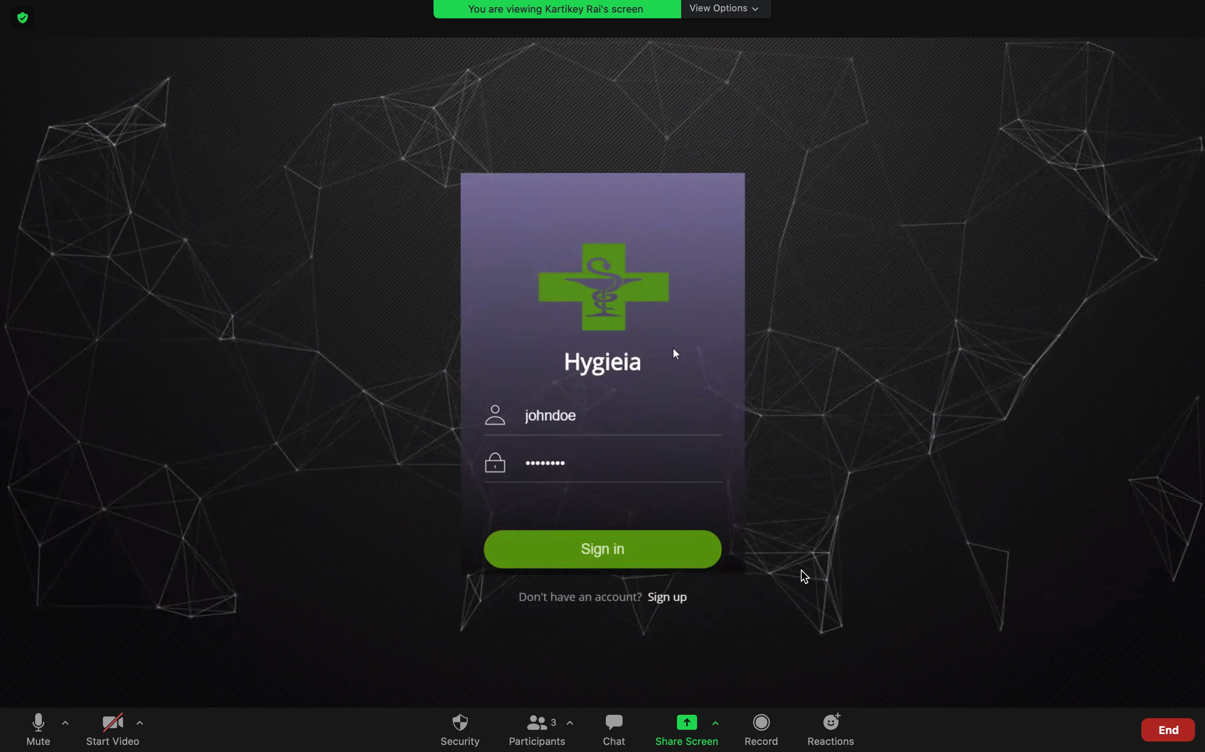
Prototype - Blockchain based Platform
5

Slide 25
What will it take - Business Case
Set-Up Cost
Cash In
Blockchain Platform Cost Data Transfer Pipeline Cost
Reduced Hospitalisation Cost
Higher Customer Engagement
Saved Administration Costs
Maintenance Cost
HUMANA
Key Stakeholders
Platform Maintenance
Platform Security
Platform Scaling
Members
Healthcare Providers
Community Health Groups
HYGIEIA
Communication Cost
Key Differentiators
Awareness Campaign Cost
User Outreach Cost
Enabling telehealth via ACOs
Gig Worker costs for Rx
Digital Identity for Members
Blockchain Network

Slide 26




Go to Market Plan
Collaborate with ACOs & Community Health Workers to improve target population outreach through telehealth
Integrate Humana Pharmacy with Gig Workers to facilitate continuous drug delivery
Establish Blockchain based Digital Identity platform via PoCs & feasibility studies
Deploy phase 1 of Blockchain based platform to enable EHR in telehealth & Digital Ad campaigns
Consortium based Awareness Campaigns
Stage 4
Stage 3
Health Consortium
Stage 2
Deploy Blockchain
Platform Integration
Stage 1
Initiate New Services
Begin Platform POC
Create Healthcare Partnerships

Slide 27
Estimated Financials
REVENUES
$ 279 M
Telehealth Setup Cost =
$ 70 Million
Blockchain Platform Cost = $ 109 Million
Awareness Campaign Cost = $ 15 Million
Medicine Delivery Cost =
$ 85 Million
Reduced Benefits Expenses = $ 200 Million
Reduced Operating Expenses = $ 126 Million
Increased Engagement Revenue = $ 128 Million
PROFIT
$ 175 M
$ 454 M
COSTS

Slide 28
Closing Thoughts
Aligns with Humana’s Vision - Everyone is entitled to a Good Life
Empower Members to take control of their own health
Provide continuous preventive care for members
Disseminate digital campaign information
Builds on existing Humana Capabilities and Goals
Modernise Humana’s Digital and Analytics Infrastructure
Enhance Humana’s Electronic Medical Records System
Create Assets that provide Patient Centred Care

Slide 29
Thank You
HYGIEIA
Team: Plaksha Kapoor, Tushar Agrawal, Archit Matta
Columbia Business School, Columbia School of Engineering & Applied Sciences

Slide 30
Appendix

Slide 31





Customer Journey
On-Boarding
Authentication
Profile synced to cloud for authentication
Blockchain-Powered System
User registers on platform
User profile captured using device sensors
Service Provided to User
Profile updated on other user devices

Slide 32
Estimated Financials - Revenue
Benefits Revenue
US Population (2005) - 295,507,000 [A]
US Population (2021) - 338,490,000 [B]
People facing Transportation Issues in 2005 - 3.6 Million [C]
People facing Transportation Issues in 2021 - 4.12 Million [(C*B)/A] = [D]
Humana Market Share - 8.4% [E]
Humana Members facing Transportation Issues in 2021 - 346,000 [D*E] = [F]
Average Reimbursement Per Member Per Year - $ 3,857 [G]
Benefits Cost Saved by Humana (15%) - $ 200.1 Million [F*G*0.15]
Administrative Costs Revenue
Humana Operating Costs (2019) - $ 7,381 Million [A]
Administrative Costs as Part of Operating Costs - 5.7% [B]
Humana Administrative Costs (2019) - $ 420.7 Million [A*B] = [C]
US vs Germany Administrative Costs - 8.3% vs 4.2% [D]
Administrative Costs Saved by Humana 30% (Estimate) - $ 126.2 Million [C*0.1]
Increased Engagement Revenue
Humana Total Revenue - $ 64,888 Million [A]
Humana Investment Income Revenue - $ 501 Million [B]
Humana Revenue excluding Investment Income - $ 64,387 Million [A-B] = [C]
Increased Customer Engagement - 0.2% [D]
Uplift in Revenue due to Increased Engagement - $ 128.7 Million [C*D]

Slide 33
Estimated Financials - Cost
Telehealth Cost:
Telehealth Cost
Total Number of Telehealth Visits per year: 22 million: (E)
Total Number of Telehealth Users at Humana: 1.848 million (F)=(B*E)
Telehealth cost per visit: $38 (G)
Total Telehealth cost per year: $70.3 million [G*F]
Blockchain Platform Cost
$0.06 per member per hour (1 / 5 th of IBM cloud Blockchain Platform)
Cost per member per year: $0.06 * 8760 = $525.6
Total Blockchain Platform Cost, assuming 60% onboarding in year 1 of people facing transportation issues (207600 people):
$109.11 million
Digital Awareness Cost
Number of Members = 22 Million [A]
Campaign Execution Cost per Member = $ 0.4 [B]
Total Campaign Execution Cost = $ 10 Million [A*B] = [C]
Campaign Planning Cost = $ 5 Million [D]
Total Campaign Cost = $ 15 Million [C+D]

Slide 34
Estimated Financials - Cost
Gig Economy Worker Engagement Cost
Total no of prescriptions filled out annually in US: $4.55 Billion
Average cost of prescriptions per person per year: $1200
Average prescriptions per person per year: 12.2
40% of drugs are delivered: 5.856
Humana’s Medicare membership: 4.07 million people
Total number of prescription delivered for Humana Medicare members: 23.8 million
Average annual salary of delivery person (gig economy worker): $27,113
Delivery per person per year: 15 deliveries a day per person * 252 working days a year = 3,780 deliveries
Number of persons required: 6300
Costs to employ workers: 6300 * 27,113 = $170.8 million
Humana bears half the cost: $ 85.4 million
$4 per delivery given per member of Humana

